Slide 1
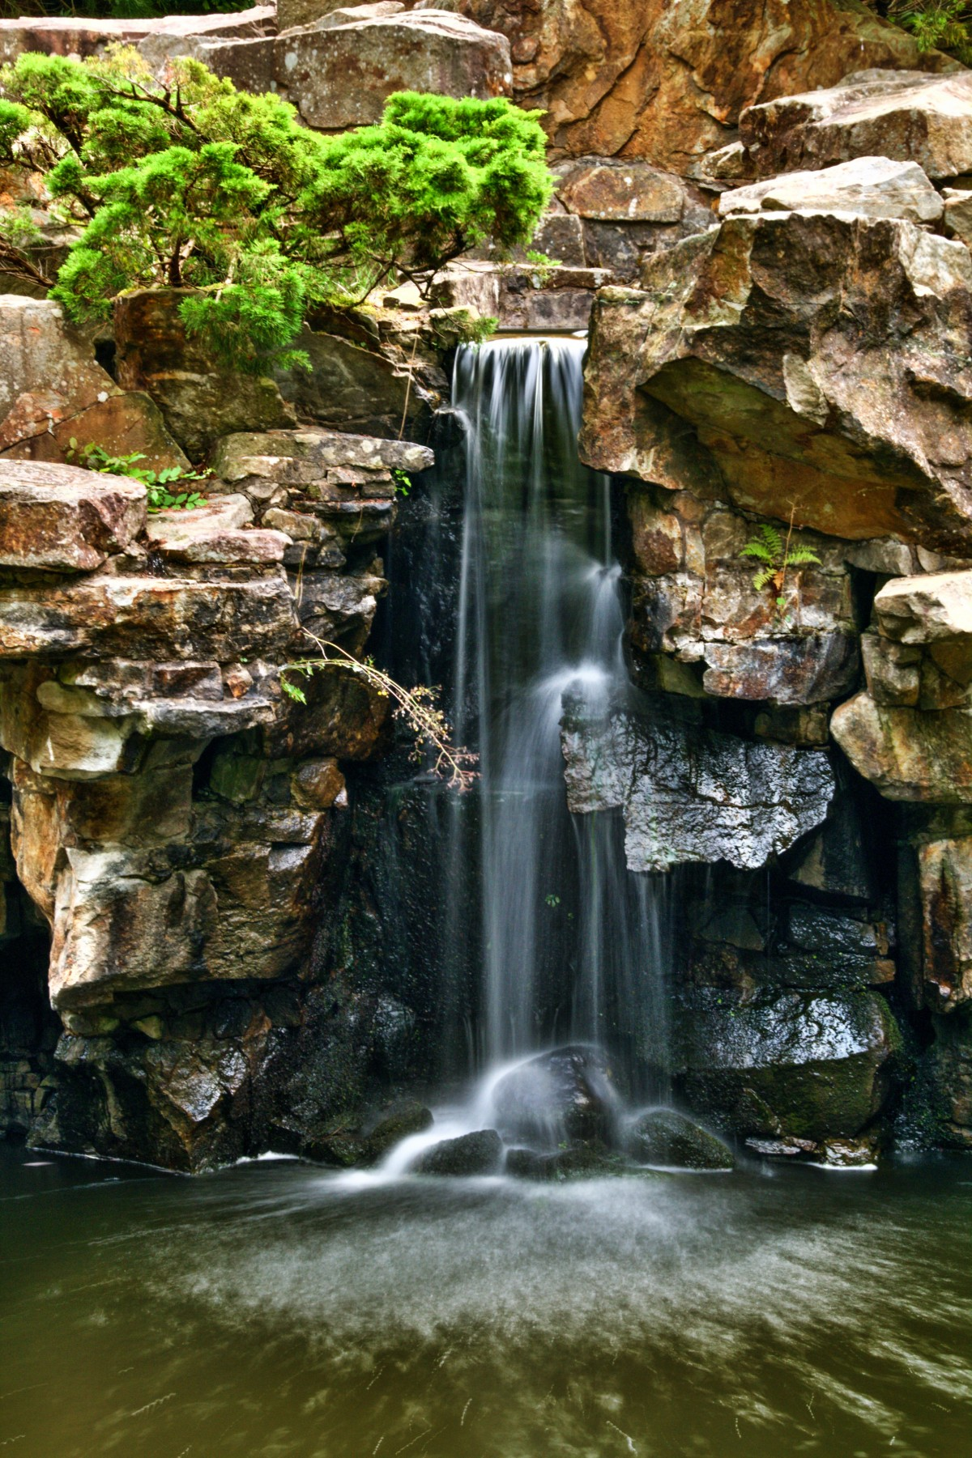
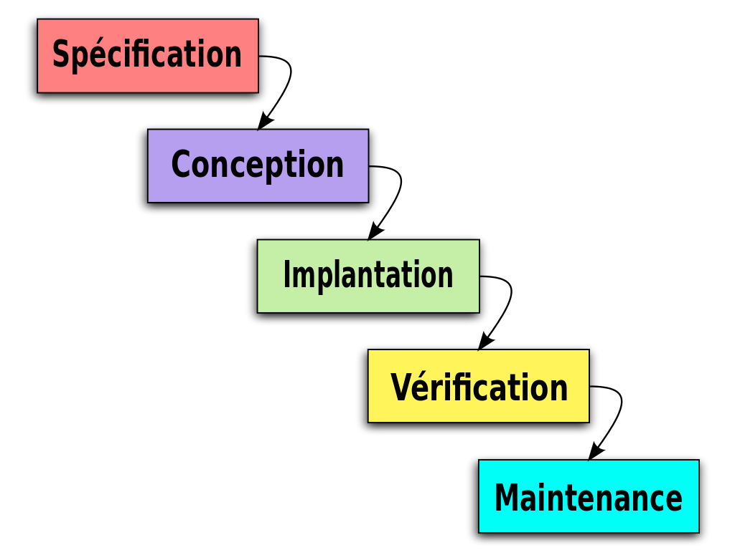
Water Fall Model:

Slide 2

DevOps:

Slide 3

About me:

Slide 4
All Jobs:
Azure administrator
Cloud Architecture
Cloud solution architecture
DevOps Engineer
Linux Admin
Automation Engineer
ETL Support Engineer
Azure DevOps Engineer
Support Engineer
Data Engineer

Slide 5


Thank You! Happy Learning

